Slide 1

CAP680
PROGRAMMING IN JAVA-LAB
The Kick Start Session

Slide 2
Java Application development
Using JDK:
https://www.oracle.com/java/technologies/downloads/
Using NetBeans:
https://netbeans.apache.org/
Using online compiler:
https://www.onlinegdb.com/online_java_compiler

Slide 3
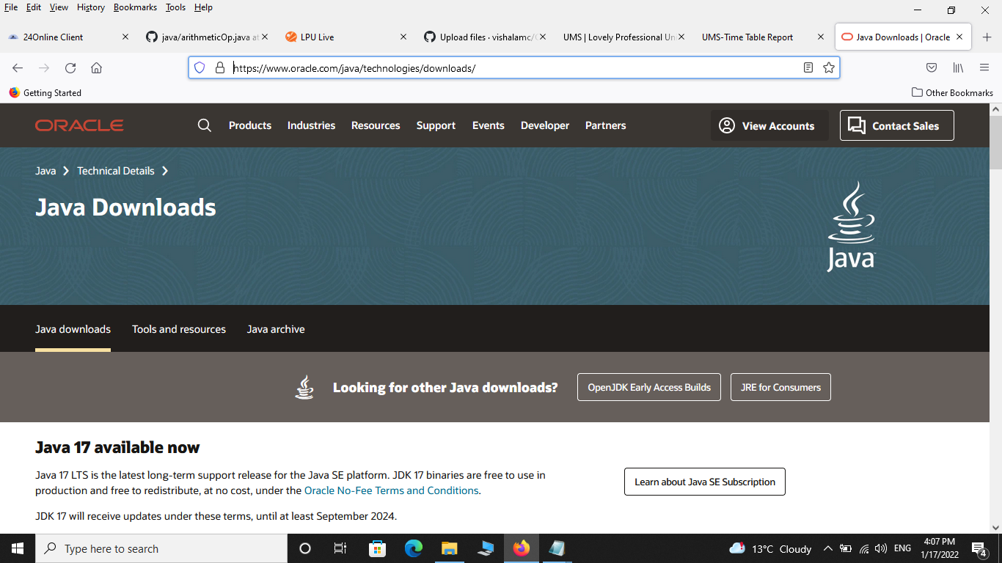
Using JDK

Slide 4

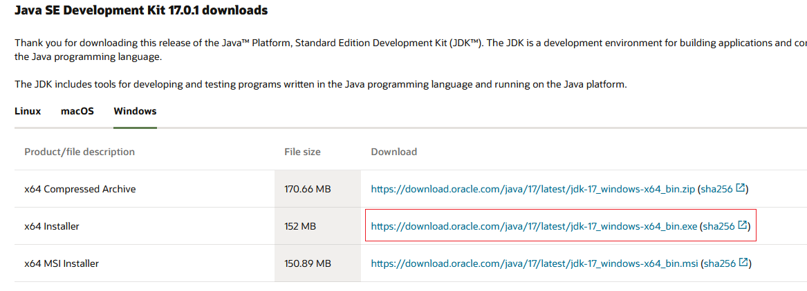
Select window tab:x64 Installer

Slide 5
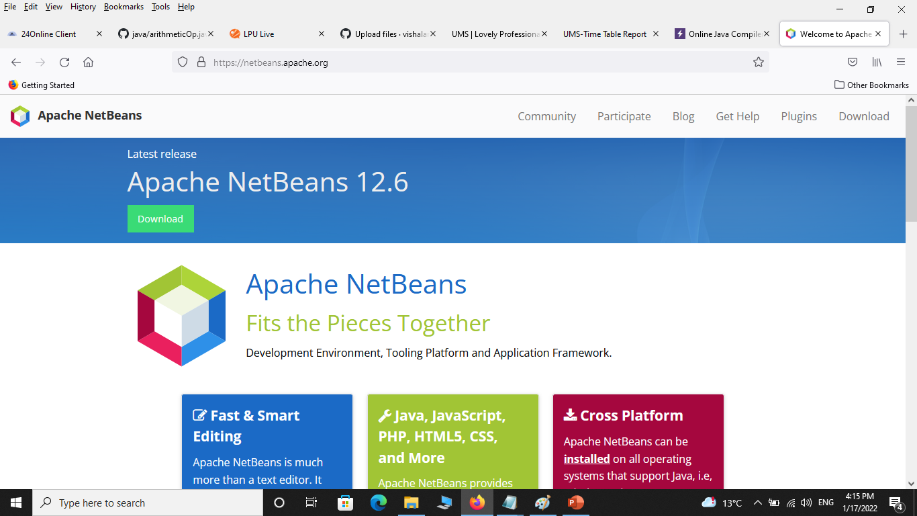
Using NetBeans IDE:

Slide 6
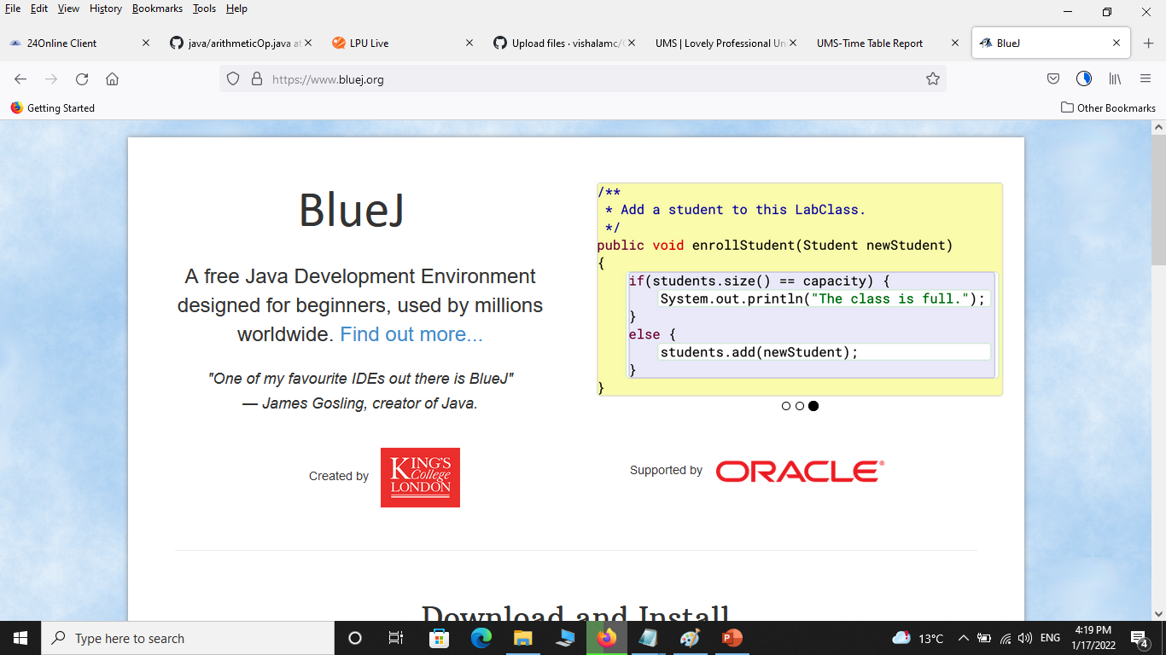
https://www.bluej.org/

Slide 7
running/ testing a java program
class test
{
public static void main(String []args)
{
System.out.println("hello");
}
}
Steps:->
Now save this file with extension .java inside bin folder in JDK.
Note: The file name should be same as class name
Now Compile this program on command prompt, suppose jdk folder is location at c: drive, open the command prompt and go inside the jdk folder.
c:/> cd jdk
now go inside the bin folder
c:/> jdk\>cd bin
c:/>jdk\bin>
Now compile the programme with javac command
c:/>jdk\bin>javac test.java
Where test.java is our filename
After compilation now run the programme by using java filename
c:/>jdk\bin>java test
Note:here during run the program no need to give the filename with extension java.
Now, you can get the output on the command line

Slide 8
java classes, objects, the main method
Class and Object:
Class is a collection of member data and member methods.
Object is an instance of class.

Slide 9
Syntax to declare a class:
class <class_name>
{
data_member;
member_method;
}
Defining scope of
The class
Class Name:
Data Member:
Member Methods:
Class Diagram

Slide 10
Basic structure of Java Program:
[ Documentation ]
[package declarations]
[import statements]
[class declaration]
[Main Merthod]

Slide 11
// A Simple java program
package test;
import java.lang;
class Demo
{
public static void main(String[] args)
{
Sytem.out.println("Hello! World");
}
}

Slide 12
Main method in Java:
public static void main(String args[])
The keyword public is an access specifier.
The keyword static is a kind of modifier. Main method is static means this is calling with out any reference.
The keyword void means that the method main() does not return any value.
Main method having parameter that array of string which show command line arguments in java. We can pass any no. of argument during run time.

Slide 13
Java Command Line Arguments
The java command-line argument is an argument i.e. passed at the time of running the java program.
Ex:
class CommandLineEx{
public static void main(String args[]){
System.out.println("Your first argument is: "+args[0]);
} }
Now compile : c:\> javac CommandLineEx.java
Now run: c:\> java CommandLineEx hello world

Slide 14
We can develop applications using Java Like:
Desktop GUI Applications
Mobile Applications
Enterprise Applications
Scientific Applications
Web-based Applications
Embedded Systems
Big Data Technologies
Distributed Applications
Cloud-based Applications
Web servers and Application servers
Software Tools
Gaming Applications

Slide 15
Companies like:
Naukri,
Jabong,
Google,
Myntra,
Flipkart,
Trivago,
ibibo
TripAdvisor
Spotify,
Uber,
TCS,
Infosys,
HCL,
Wipro,
Pinterest,
eBay,
        etc use Java.

Slide 16



